Slide 1
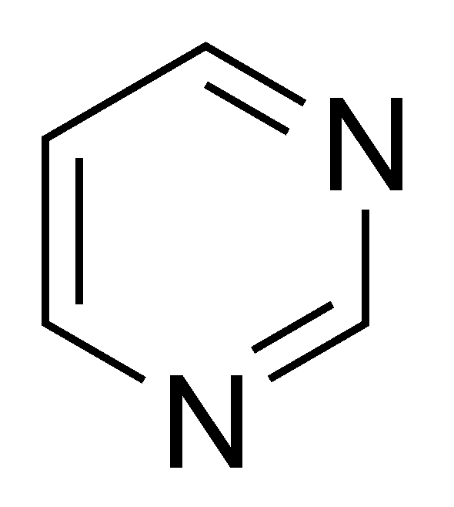
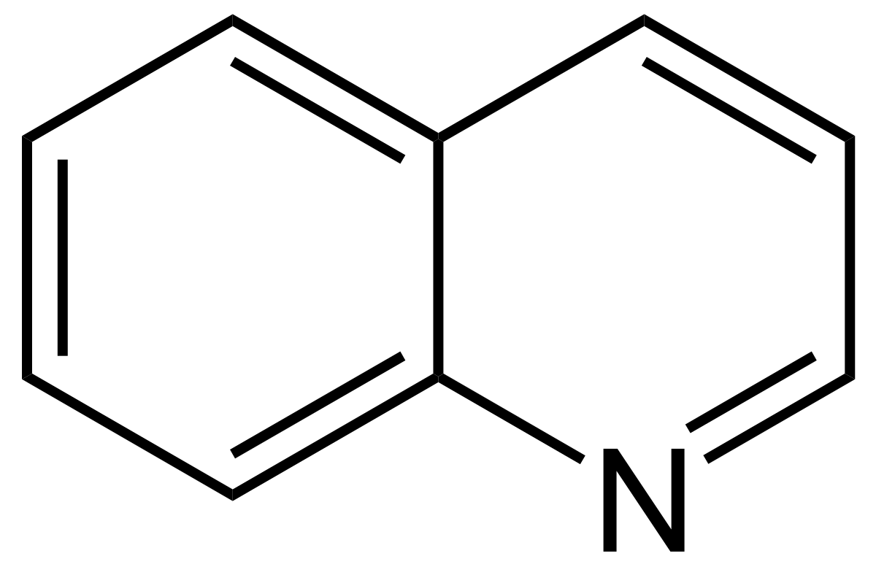
The Synthesis and Exploration of Catalytic Activity toward Synthesis of Pyrimidine and Quinoline
Presentation by Jessica Whitehouse
Objective:
Find the manganese complex with the highest catalytic activities when synthesizing N-heterocycles such as pyrimidines(figure 1) and quinolines(figure 2).
Methodology:
All experiments were done in an argon atmosphere using glovebox or standard Schlenk line techniques. Each Mn complex was derived separately, using bromopentacarbonyl manganese(I) and toluene in varying concentrations, along with varying pyridine complexes for each manganese complex. Each mixture was refluxed at 110°C for 10 hours.
To synthesize the N-heterocycles from Mn1, the Mn1 complex was dispensed into an RBF along with NaOMe and MeOH at room temperature. The solids were filtered and dried under reduced pressure. IR spectra were recorded along with ESI-MS and NMR. The Mn1 solid-state structure was characterized by X-ray crystallographic studies.
Results and Discussion:
The Mn complexes were synthesized with yields ranging from 67-88%. Using the format from Figure 3, the catalytic activity of each Mn complex was measured. The best yield at a reduced time from Mn1 used Mn1 0.05mol% with KOH (0.25equiv) at a time of 12 hours and a yield of 91%. The other Mn complexes could reduce the time to 6 hours, but their yields ranged from 60-76%, which were considerably lower than the Mn1 complex. This indicates that the 2-hydroxypyridine functional group plays a vital role in the catalytic activity of the Mn complex.
Figure 1: Structure of pyrimidine
Background:
Due to their low toxicity, low cost, and accessibility, 3rd-row earth-abundant transition metals are becoming increasingly popular as tools in the research communities. Manganese is one of the transition metals that has been gaining popularity, specifically for its reactivity with a diverse range of catalytic transformations. Prior to this report, there were no publications relating to Mn(I)-based metal complexes bearing benzimidazole- and 2-hydroxypyridine-based ligands.
Figure 2: Structure of quinoline
Conclusion:
The Mn1 complex was the most efficient catalyst in the synthesis of N-heterocycles, while the Mn2, Mn3, and Mn4 were the least efficient in the synthesis of N-heterocycles.
Future work:
As this research set the maximum concentration of Mn catalytic complex at 0.05(x mol%), it would be interesting to see how much time could be reduced if the catalyst concentration was raised. As the highest yield also had a reaction time of 12 hours, the increase of the catalyst could possibly shave down a few hours.
Figure 3: General reaction conditions for catalyst activity measurement
References:
Nandi, S; Borthakur, I; Ganguli, K; Kundu, S. Organomet 2023, 42,1793-1802
Figure 4: The synthesized Mn(I) complexes

