Slide 1
Determination of Method Validity of Identifying the Presence of Titanium Dioxide in Commercial Pool Care Products via Raman Spectroscopy
Research and presentation by Maddie Hubbard, Dylan VanSpankeren, Jessica Whitehouse

Slide 2
Objective
The initial goal of this experiment was to determine the concentration of TiO₂ in the commercial pool care product Solei Sun Powered Water Care.
This goal then developed into the determination of method validation of identifying TiO₂ in Solei Sun Powered Water Care as the experiment progressed.

Slide 3
Background
The real sample tested is a patent pending pool care product. The analyte, TiO₂, is what makes this product special as it aims to reduce the levels of chlorine in household pools
The exact concentrations are not listed which led us to wanting to try and determine the concentration of TiO₂ ourselves
TiO₂ is a commonly used chemical for colouring products white. It is used in products such as paints, plastics, paper, and soaps
Raman was the instrument of choice as it is powerful at detecting specific structures along with its short run time

Slide 4
Instrument Specifications
Raman Spectrophotometer (Anton Paar Cora 5001)
785nm wavelength
250s exposure time
450mW laser power

Slide 5
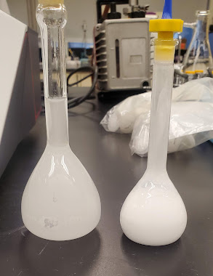
Experimental: Week 1
Created two stocks with TiO₂ powder and water
Stock 1
Vortexed and sonicated
Appeared white, opaque, and grainy
See right side of figure
Filtered through 0.45µm luer lock
686ppm
Stock 2
Thoroughly hand-shaken
See left side of figure
26ppm

Slide 6
Week 1 Cont’d
Blank sample contained water
This run was subtracted from future runs
Real sample was run
Once as undiluted
Once spiked with 3.5mL stock 1 in 10mL flask
Once spiked with 5mL stock 2 in 10mL flask
Once spiked with 1mL stock 2 in 100mL flask

Slide 7
Tables for Concentrations: Week 1
Dilute Stock Solution | Diluted from Stock Solution # | Volume of Stock Solution Used (mL) | Volumetric Flask (mL) | Concentration (ppm)
3 | 1 | 3.5 | 10 | 240
4 | 2 | 5.0 | 10 | 13
5 | 2 | 1.0 | 100 | 0.26
Stock Solution | Mass of Solid TiO₂ (g) | Volumetric Flask Used (mL) | Concentration (ppm)
1 | 0.0343 | 50 | 686
2 | 0.0026 | 100 | 26

Slide 8
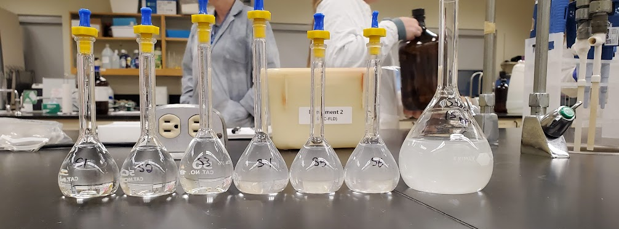
Week 2
A stock with 3.7mg TiO₂ powder in a 250mL flask was prepared (15ppm)
This was used to prepare nine standards, mixed with real sample, in a standard addition fashion
Each standard was run once, along with a water blank which was subtracted

Slide 9
Week 2 Cont’d
The real sample was also directly spiked with the TiO₂ powder in 250mL volumetric flasks with varying masses
Less than 4.7mg
4.7mg
27.9mg
These spiked samples were filtered through 0.45µm luer lock

Slide 10
Tables for Concentrations: Week 2
Standard | Real Sample Volume (mL) | TiO₂ Stock Solution (mL) | Deionized Water (mL)
1 | 10 | 0 | 40
2 | 10 | 5 | 35
3 | 10 | 10 | 30
4 | 10 | 15 | 25
5 | 10 | 20 | 20
6 | 10 | 25 | 15
7 | 10 | 30 | 10
8 | 10 | 35 | 5
9 | 10 | 40 | 0
Spiked Real Sample | Mass of Solid TiO₂ (mg) | Volume of Real Sample (mL) | Position (cm⁻¹) | Peak Height (a.u.)
1 | 4.70 | 250 | 129.57 | 267.42
2 | 27.9 | 250 | 129.68 | 145.29
3 | <4.70 | 250 | 129.82 | 187.53

Slide 11
Data and Results
While this was not a quantitative experiment, an analysis of the spectra can show the validity of the method

Slide 12
Filtered Real Sample

Slide 13
Spiked with less than 4.7mg

Slide 14
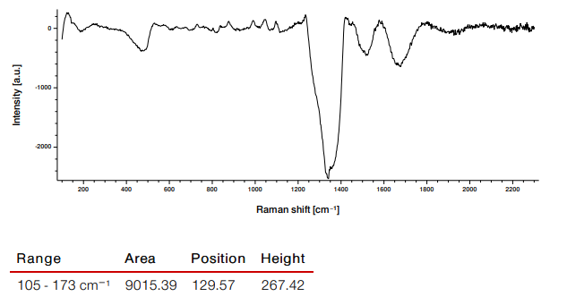
Spiked with 4.7mg

Slide 15
Spiked with 29.7mg

Slide 16
Conclusion
This experiment involved constant trial and error to get consistent results from the samples
The TiO₂ proved difficult to work with as it is a very powerful dye and does not dissolve well
The final method of spiking the sample directly with the powder proved to have the most validity to it
By doing this the peak correlating to TiO₂ grew in height. The overall solution colour remained constant after filtering suggesting there is a process occurring in the real sample to remove solid TiO₂ pieces

Slide 17
Future Work
Future work would involve the continuation of method development to a point that would allow for the initial goal to be achieved.
Since there was increasing peak heights as the amount of stock sample added changed, this leads us to believe there is merit to this method.
Another option would be exploration of other solvents to dissolve TiO₂. This would require more work dealing with different matrixes but could prove useful

